Slide 1
Punch Card Music Box
Maurice Woods
ASEN 5519 :: Final Project

Slide 2
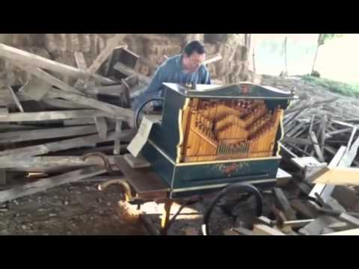
Project Description :: Design and Motivation
Maurice Woods
ASEN 5519 :: Final Project
Punch Card Music Box :: Slide

Slide 3
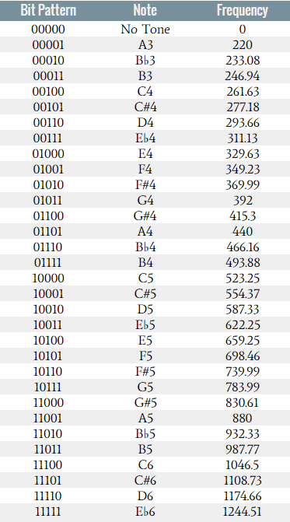
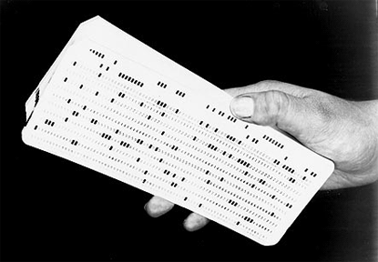
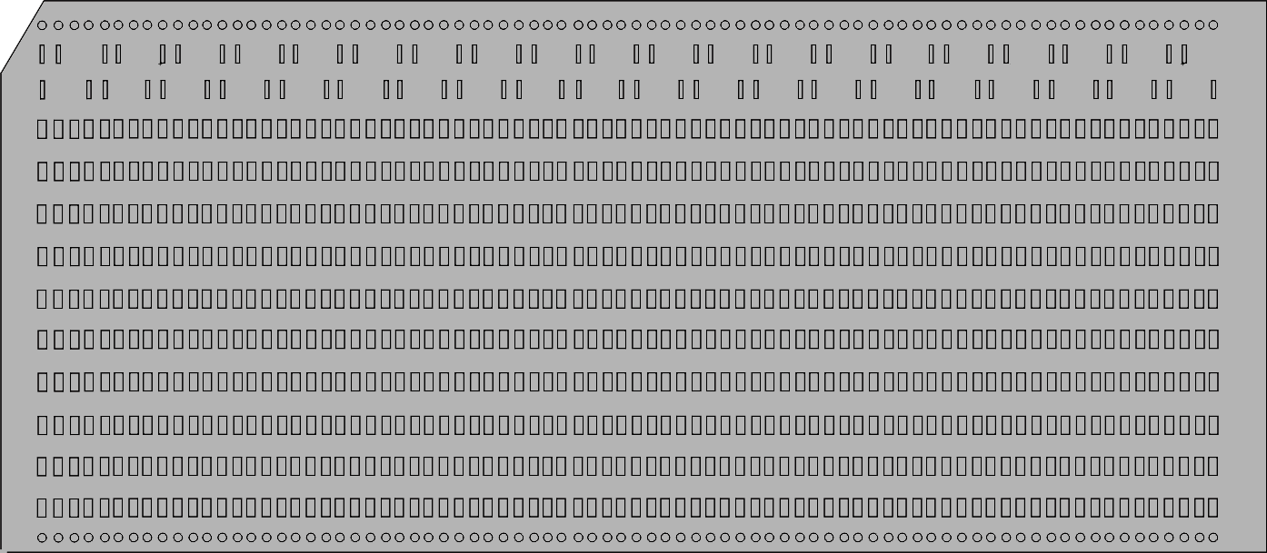
Project Description :: Design and Motivation
As a testament to historical inefficiencies of computer programming...
“Create a music box that, much like a player piano, uses punch cards as an input to play certain, sequenced tones automatically...”
Play settings include...
Optical sensors detect punch holes
Variable tempo set by user
2 notes w/ range of ~2 octaves
1 note w/ range of ~6 octaves
Servo Feed Holes
Grey Code (Positioning/Encoding)
Note 1 (5 bits)
Note 1 (5 bits)
Maurice Woods
ASEN 5519 :: Final Project
Punch Card Music Box :: Slide

Slide 4
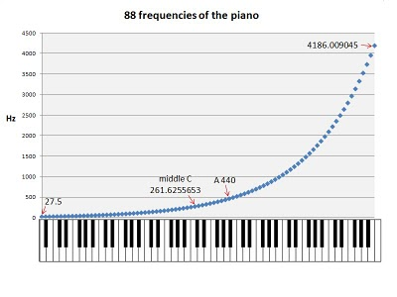
Mechanical Overview :: Structure and Assembly
Punchcard provides space for:
80 lines
Line is 10 bits (+2 added grey bits)
Alternate: 1 line w/ two 5-bit notes 1 line w/ one 7-bit note
Data Memory can be linked for:
3 x 928 note sequences
9281/16th notes = 58measures in 4/4 = 3.8min - 1.2min
7-bit range
5-bit range
@60bpm @200bpm
Maurice Woods
ASEN 5519 :: Final Project
Punch Card Music Box :: Slide
Servo Feed Holes
Grey Code (Positioning/Encoding)
Note 1 (5 bits)
Note 1 (5 bits)

Slide 5
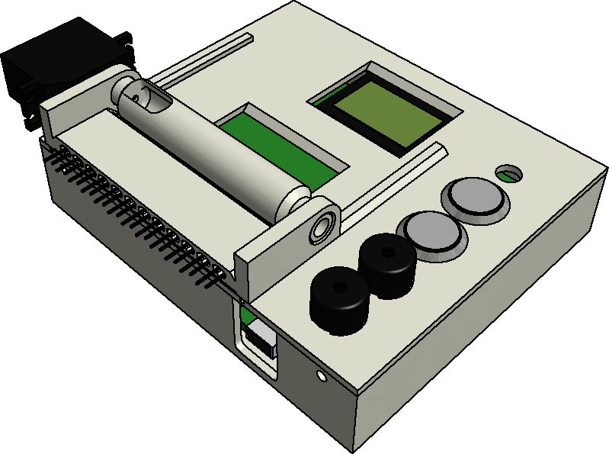
Mechanical Overview :: Structure and Assembly
1 x Continuous Servo
(12x2) x Infrared Emitter / Detectors
1 x PIC Baseboard (MCU, Potentiometer, and LCD)
3 x Piezo Speakers
2 x Pushbutton Switch
1 x Enclosure (Feed Roller and Blackout Slot)
≤28 x Punch Card(s)
Maurice Woods
ASEN 5519 :: Final Project
Punch Card Music Box :: Slide

Slide 6

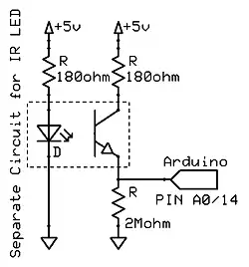
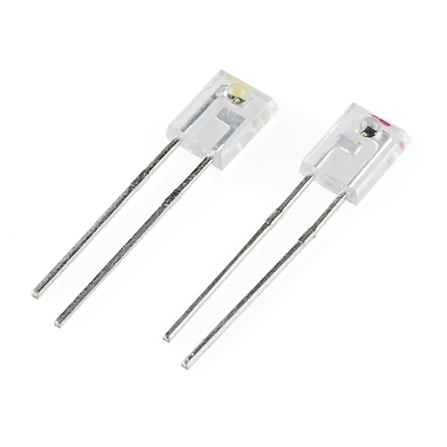
Electrical Overview :: Circuit Diagram
Speakers
Pushbuttons
IR Emitter
Potentiometer
Servo
IR Detector
Maurice Woods
ASEN 5519 :: Final Project
Punch Card Music Box :: Slide

Slide 7
Software Overview :: Software Hierarchy
MODE 1 New Song / Erase Memory
MODE 2
Read / Feed Card
MODE 3
Set Tempo
MODE 4
Play Song
Servo Feed Card
Determine Frequency of First Notes
New Song or Play Existing?
ADC Read Potentiometer
Play Song
HI PRIO ISR
Hole Detected?
HI PRIO ISR
HI PRIO ISR
No
New Song
Yes
Load CCP with Half Period
Store Bits in Song Stack
Zero the song pointer
Accept Tempo?
80 Lines Read?
No
Yes
Toggle Speaker Pin
No
Yes
More Cards?
Stack Top Reached?
Yes
No
No
Yes
Maurice Woods
ASEN 5519 :: Final Project
Punch Card Music Box :: Slide

Slide 8
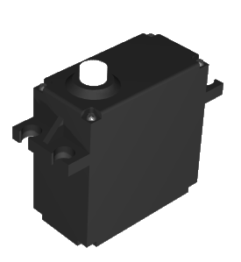

Software Overview :: Timing’s the Tricky Part
Three Considerations with Timing:
A4
440Hz
C6
1046Hz
B♭2
116Hz
Servo Feed Rate CCP1
3 Simultaneous Pitches CCP2, CCP3, and CCP4
Tempo (1/16th Note Length) CCP5
Maurice Woods
ASEN 5519 :: Final Project
Punch Card Music Box :: Slide

Slide 9
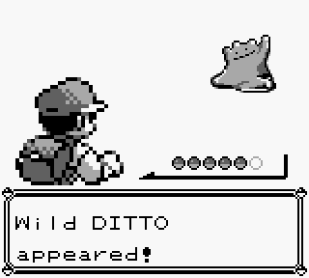
Results :: Flippin’ Sweet!
.. .
.
...
..
. .
....
.. .
..
..
. .
....
. .
..
. .
. .
....
.. .
.
...
..
. .
....
. .
..
. .
. .
....
. .
..
. .
. .
....
A New Song appeared!
Maurice Woods
ASEN 5519 :: Final Project
Punch Card Music Box :: Slide

Slide 10
Punch Card Music Box
Maurice Woods
ASEN 5519 :: Final Project

